Slide 1


Slide 2
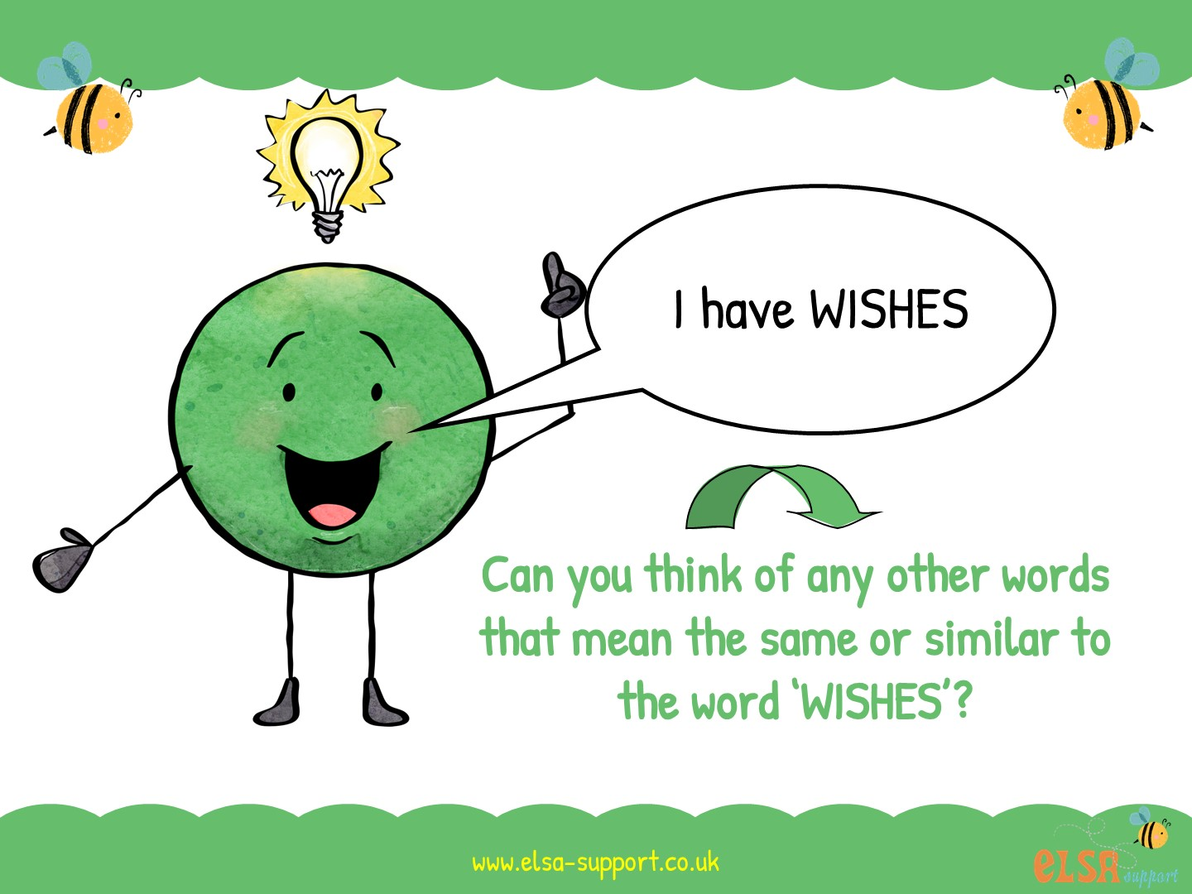

Slide 3

dreams
hopes
goals
ambitions
Can you think of a time when you had a wish?

Slide 4
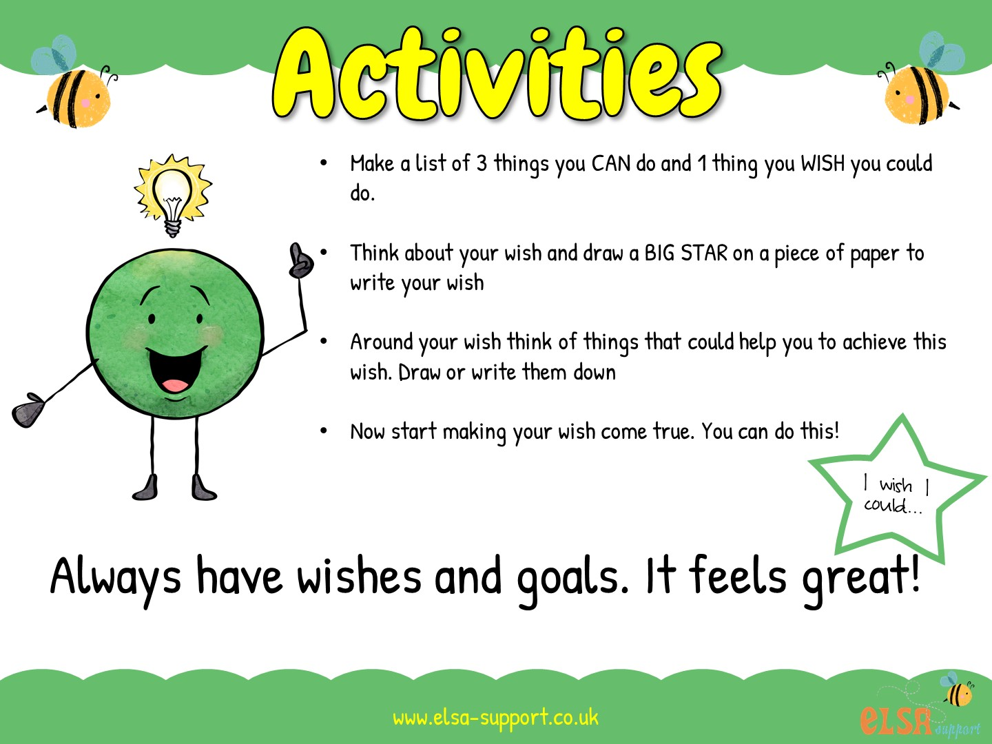

Slide 5


Slide 6
