Slide 1


Slide 2
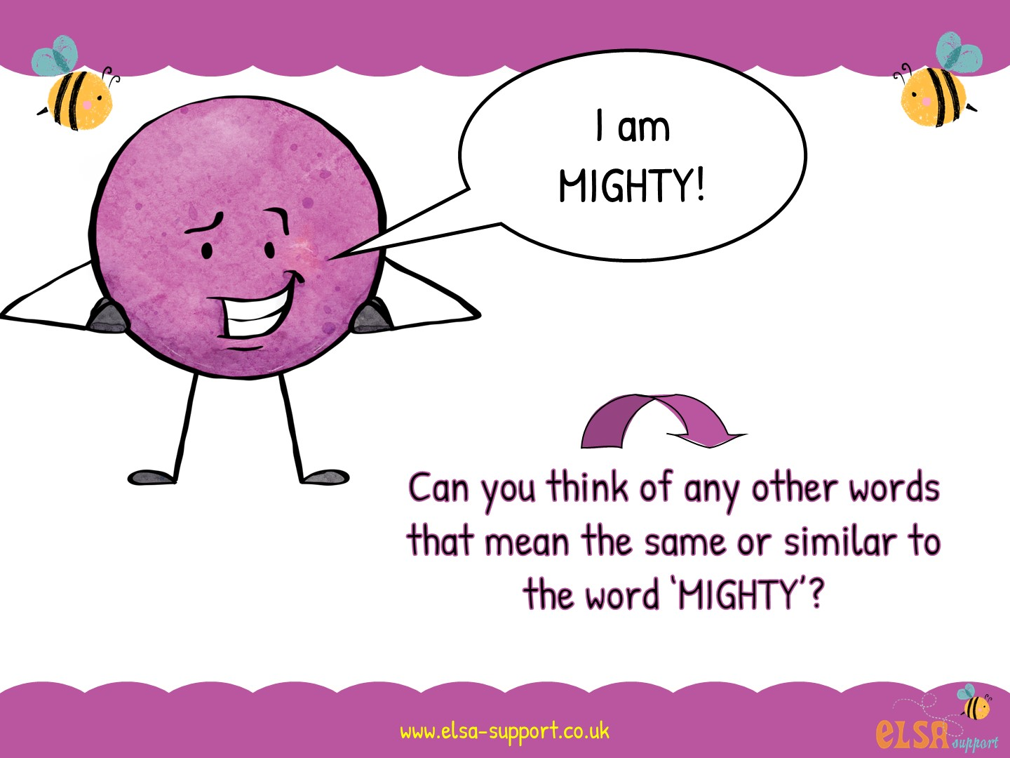

Slide 3
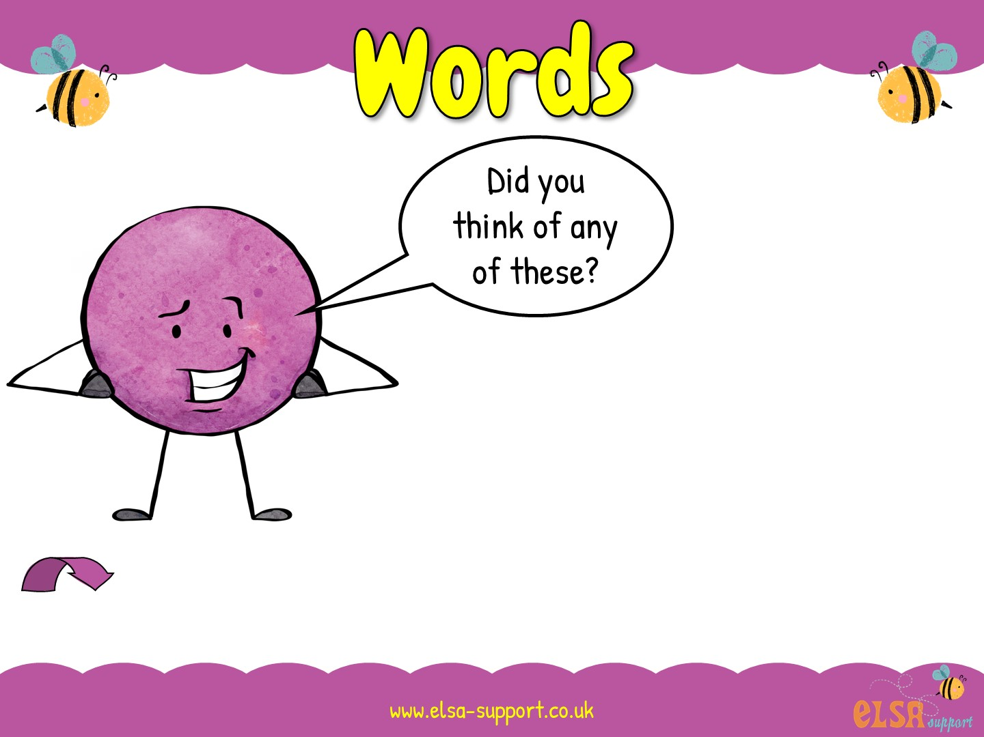
brave
strong
confident
bold
Can you think of a time when you felt like this?

Slide 4
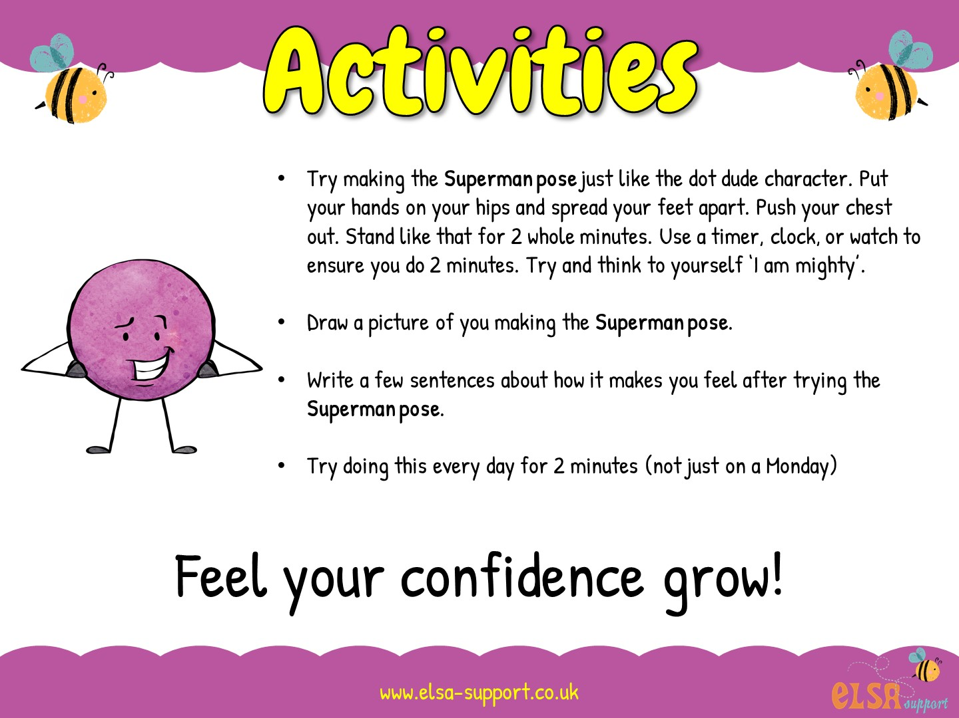

Slide 5
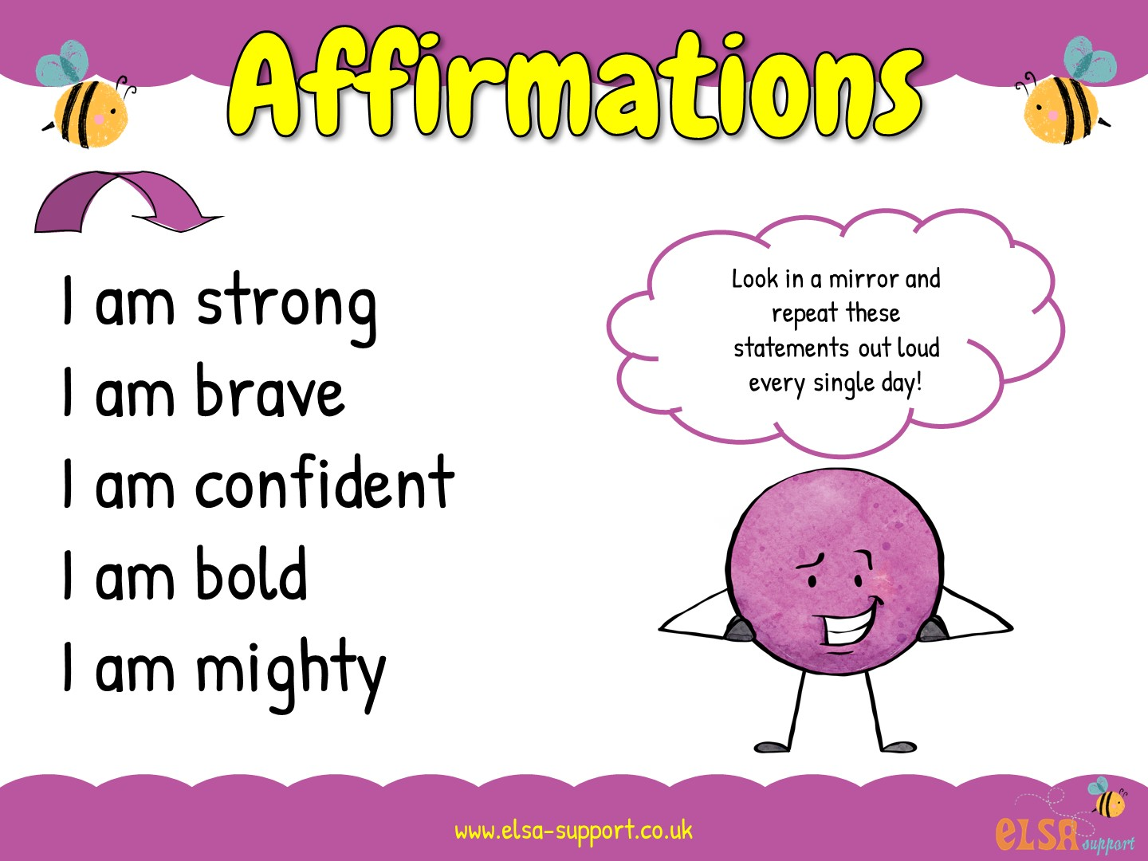

Slide 6
