Slide 1


Slide 2
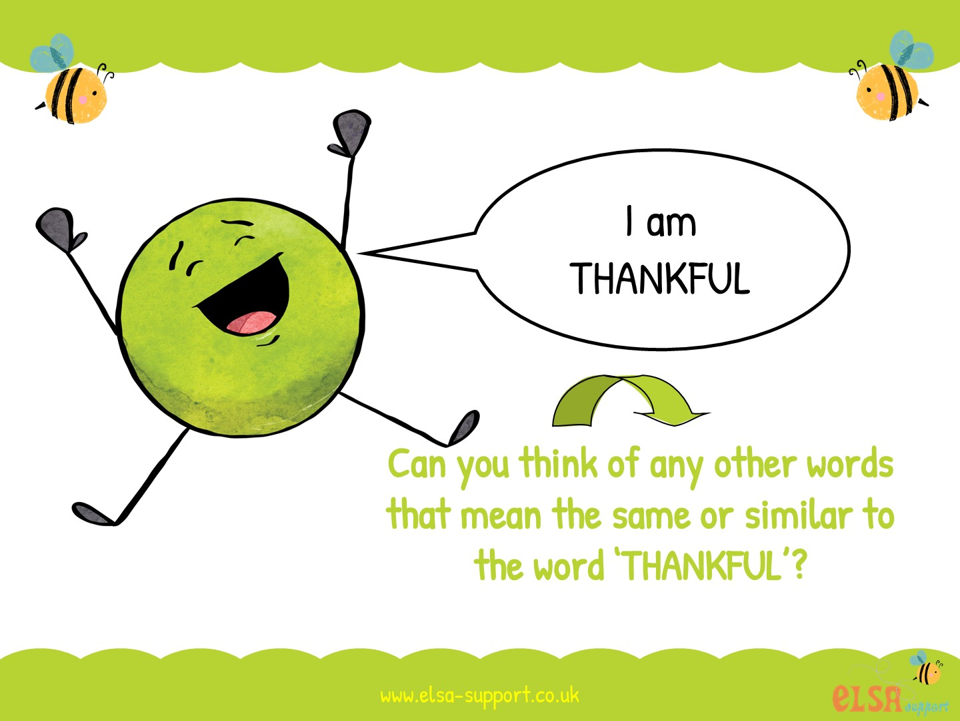

Slide 3
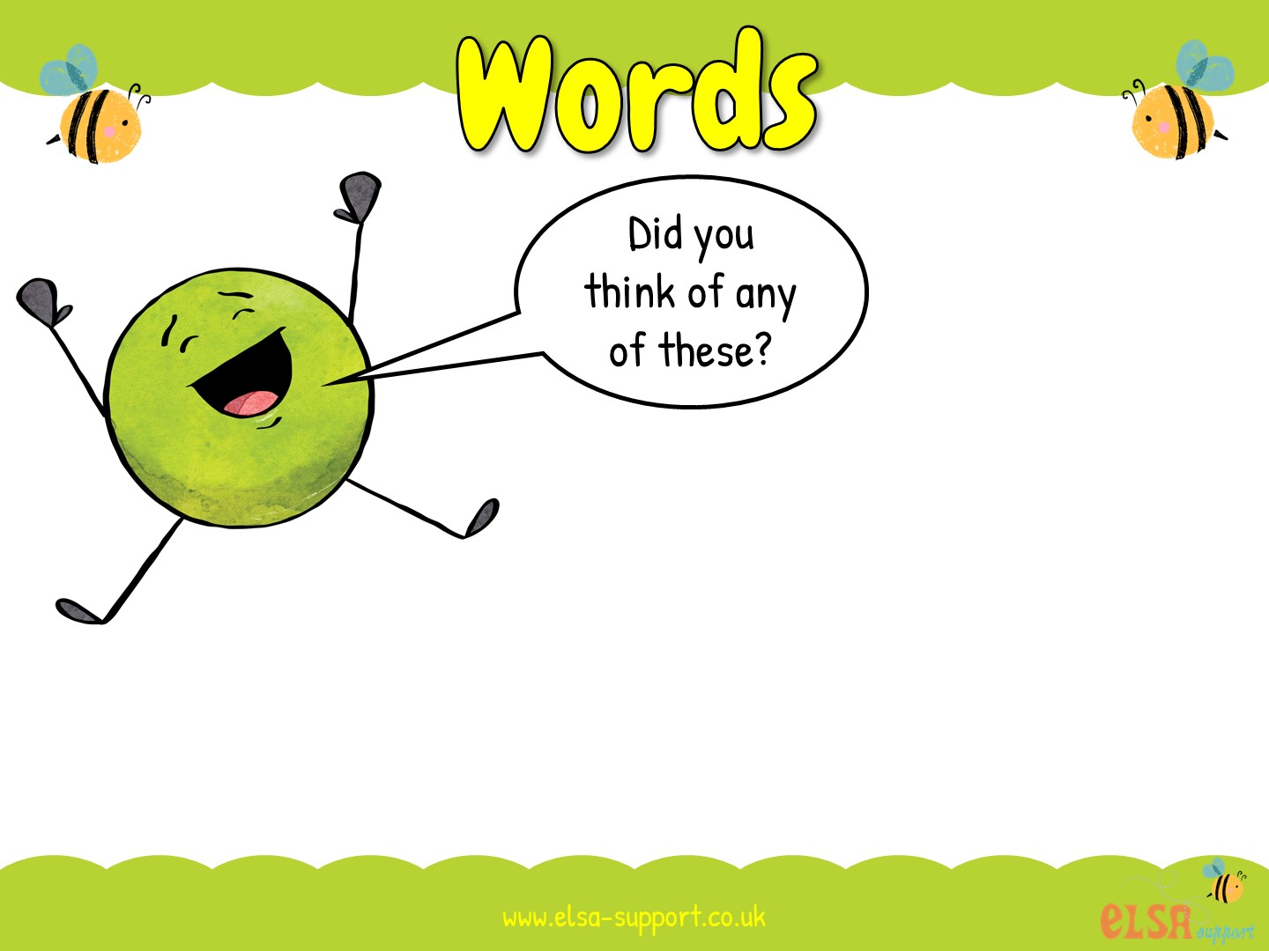
glad
thrilled
pleased
grateful
Can you think of a time when you were thankful?

Slide 4
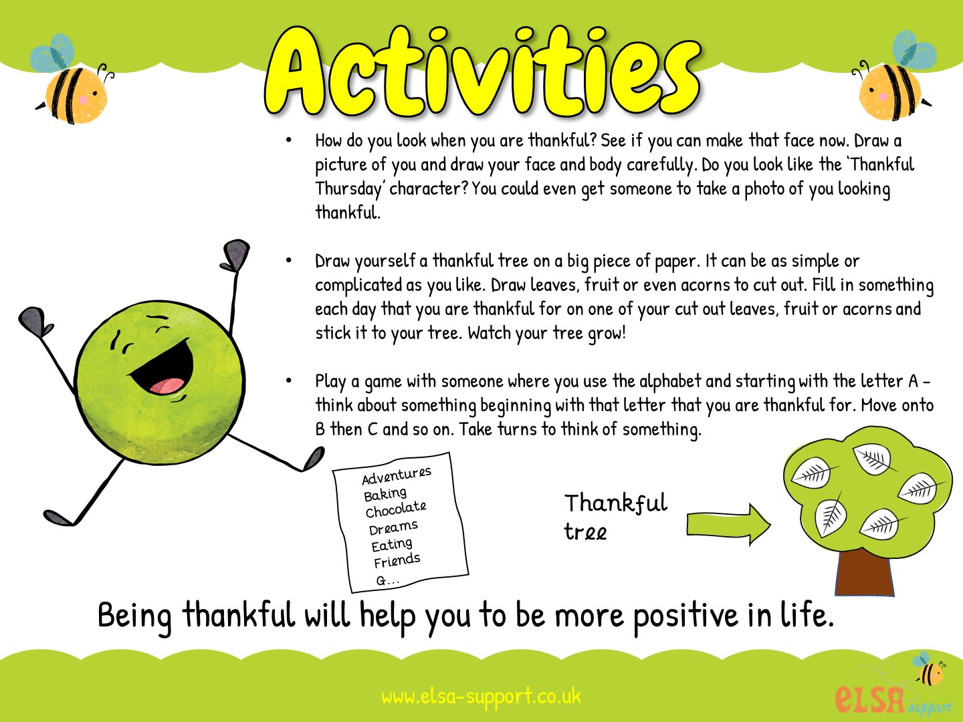

Slide 5
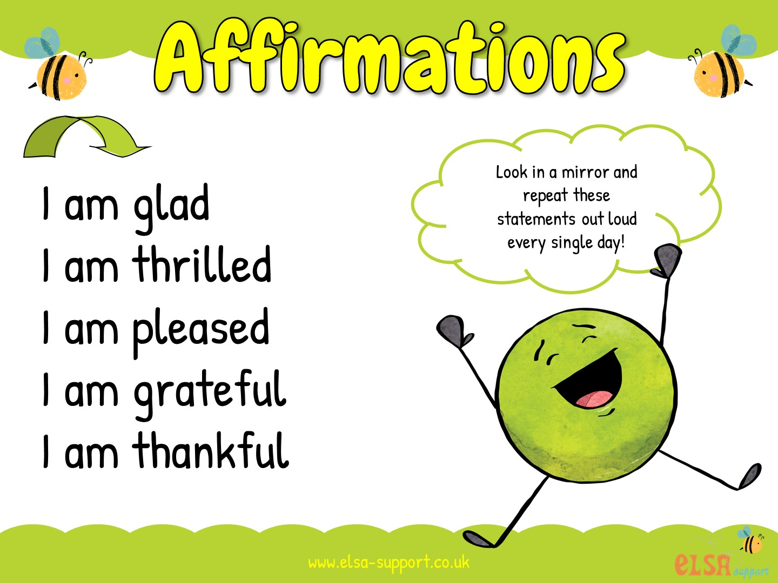

Slide 6
